Slide 1

Influential Node Detection in Weighted Graphs using Graph Convolutional Networks Honours Project Phase1 Review2
By
Albin John
2023BCD0005
Guided By,
Dr. Jisha Mariyam John

Slide 2
Outline
Introduction & Motivation
Problem Statement & Objectives
Methodology - NLGCN Framework
Structural Features (NLI & NGI)
Model Architecture
Experimental Setup & Datasets
Results - Kendall Tau Correlation
Results -Top-10 Node Identification
Discussion
Limitations
Future Work
References

Slide 3
Introduction & Motivation
Influential Node Detection
Complex systems such as social, biological, financial, and transportation networks are modeled as graphs. In complex networks, not all nodes contribute equally.
Some nodes play a critical role in:
• Information diffusion & viral marketing
• Epidemic spreading & vaccination strategies
• Network stability & infrastructure resilience
Identifying these critical nodes efficiently is a fundamental problem in network science.

Slide 4
Motivation — The Gap
Why existing methods fall short:
Limitation 1 : Traditional centrality measures (Degree, Betweenness, K-Shell)
• Rely on a single structural perspective
• Cannot capture multi-scale influence patterns
Limitation 2 : SIR Simulation-based approaches
• Accurate but computationally expensive - O(n³)
• Do not scale to large networks
Solution: NLGCN [3], a fast, learning-based method combining multi-scale structural features with convolutional deep learning

Slide 5
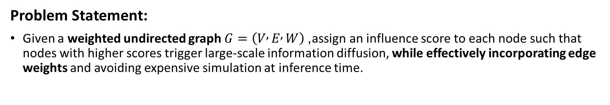
Problem Statement & Objectives
Problem Statement:
Given a weighted undirected graph $G=\left(V , E , W\right)$, assign an influence score to each node such that nodes with higher scores trigger large-scale information diffusion, while effectively incorporating edge weights and avoiding expensive simulation at inference time.
Key Objectives:
Extend influence estimation to weighted networks by incorporating edge weights into structural representations.
Implement a learning-based framework (NLGCN) that captures both topological structure and weight information for accurate influence prediction.
Approximate diffusion behavior (SIR-based) through supervised learning to eliminate costly simulations during inference.
Evaluate performance on graphs using ranking metrics (e.g., Kendall Tau) and diffusion-based measures.

Slide 6
Methodology — NLGCN Framework
Three- Stage Pipeline:
Stage A: Node Feature Extraction
• Compute NLI (Node Local Influence) and NGI (Node Global Influence)
• Multi-scale aggregation at 3 orders (L = 0, 1, 2)
Stage B: Structural Channel Construction
• 6 structural channels embedded into neighbourhood matrices
• Channel tensor: 6 × (L+1) × (L+1)
Stage C: Model Prediction
• Channel attention mechanism (Squeeze-Excitation)
• Conv2D layers → FC layers → scalar influence score

Slide 7
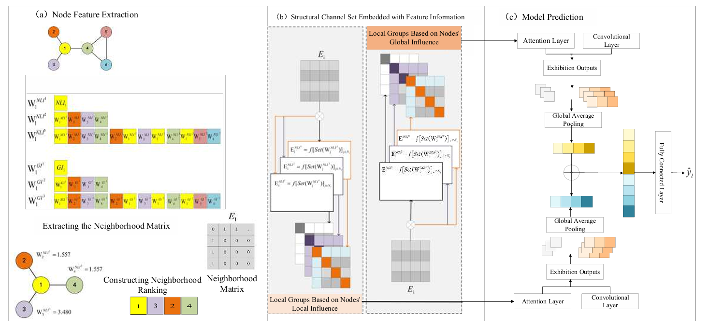
NLGCN Framework
Basic Framework of Neighborhood Local Graph Convolutional Network [3].

Slide 8


Structural Features — NLI & NGI
Node Local Influence (NLI):
• Captures importance based on immediate neighbourhood structure
• Exponential amplifies influential neighbours and log prevents extreme values
Node Global Influence (NGI):
• Captures influence across the entire network via shortest path distances
• Closer nodes contribute more and square root slows decay for distant nodes

Slide 9
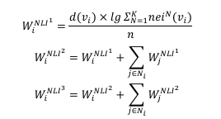


Structural Features — NLI & NGI
Multi-Scale Aggregation (for both NLI and NGI):
Base feature value
1-hop aggregation
2-hop aggregation

Slide 10
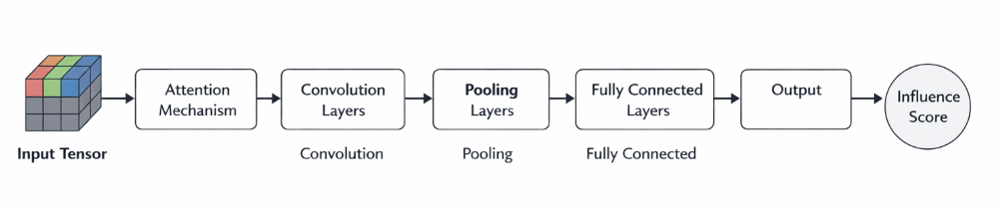
NLGCN Model Architecture
Input Tensor: 6 × (L+1) × (L+1) — 6 structural channels stacked
Channel Attention: Squeeze-Excitation mechanism
• Dynamically weights channels, important channels get higher attention
Conv Layer: Conv2d (6 → 16, kernel_size=2) + BatchNorm2d + ReLU + MaxPool2d (2)
FC Layers: Linear(16×20×20 → 8) + ReLU → Linear(8 → 1)
Final output: single scalar influence score per node

Slide 11
Datasets
Four real-world networks spanning different domains and scales:
Dataset | Nodes | Edges | Avg. Degree | Network Type
C. elegans | 297 | 2,148 | 14.46 | Biological neural network
Budapest | 480 | 1,000 | 4.17 | Transportation network
US Airports | 500 | 2,980 | 11.92 | Airport route network
CargoShipsBB | 834 | 4,349 | 10.43 | Cargo shipping network
All datasets: unweighted, undirected graphs. Budapest: 11 self-loops removed during preprocessing. Average degree computed as 2 × |E| / |V|.

Slide 12
Results — Kendall Tau Correlation
NLGCN vs. Baseline Centrality Methods:
Method | C. elegans | Budapest | US Airports | CargoShipsBB
Degree Centrality | 0.7472 | 0.5537 | 0.6503 | 0.7874
K-Shell | 0.7683 | 0.6277 | 0.6898 | 0.8246
Betweenness | 0.5723 | 0.2729 | 0.3592 | 0.5957
NLGCN | 0.9627 | 0.9164 | 0.8944 | 0.9237
Key Findings: ✓ NLGCN achieves highest Kendall Tau on all 4 datasets (0.8944 – 0.9627) ✓ K-Shell is strongest baseline (0.6277–0.8246), Betweenness weakest ✓ Largest improvement on Budapest (+46% over K-Shell) — sparse networks benefit most

Slide 13
Top-10 Influential Node Identification
NLGCN correctly identifies the exact same top-10 most influential nodes as the SIR ground truth on every dataset evaluated.
C. elegans: [2, 44, 12, 84, 86, 118, 117, 4, 172, 125] — 10/10
Budapest: [7, 21, 1, 23, 65, 83, 35, 13, 6, 151] — 10/10
US Airports: [0, 100, 93, 31, 37, 40, 36, 62, 108, 110] — 10/10
CargoShipsBB: [63, 53, 187, 40, 122, 116, 76, 303, 117, 49] — 10/10
CargoShipsBB has a minor reorder at ranks 3–4 (187 ↔ 40) but the exact same set of nodes is identified.
This demonstrates practical utility — NLGCN can replace expensive SIR simulation at inference time with a single forward pass.

Slide 14
Discussion — Why NLGCN Outperforms
1. Multi-Scale Representation
• 6 structural channels (NLI + NGI × 3 orders) encode both local & global properties
• Richer than any single centrality measure
2. Channel Attention Mechanism
• Dynamically weights channels per network type
• Dense networks → NGI upweighted | Sparse networks → NLI upweighted
• Adaptive without manual feature selection
3. Hierarchical Aggregation
• Iterative neighbourhood summation propagates information across hops
• Captures 2-hop patterns that single-hop methods completely miss
• Particularly beneficial for sparse networks (Budapest: +46% over K-Shell)

Slide 15
Limitations
1. Scalability
• NGI requires all-pairs shortest paths — O(n³)
• Feasible for 297–834 nodes; needs approximation for large-scale networks
2. Hyperparameter Sensitivity
• Performance depends on L (neighbourhood size) and α (NGI balancing constant)
• Grid search could yield further improvements
3. Static Graph Assumption
• Assumes static, unweighted, undirected graphs
• Does not account for temporal evolution - limits applicability to dynamic networks

Slide 16
Future Work
1. Extension to Weighted Graphs (Priority)
• Replace binary adjacency with weighted matrix W_ij
• Modify NLI/NGI to incorporate edge weights
2. Extension to Directed & Dynamic Graphs
• Handle directed edges (Twitter, citations, web graphs)
• Account for temporal network evolution
3. Alternative Diffusion Models
• Independent Cascade (IC) and Linear Threshold (LT) models

Slide 17

Plagarism Report

Slide 18
References
[1] D. Chen, L. Lü, M.-S. Shang, Y.-C. Zhang, T. Zhou, "Identifying influential nodes in complex networks," Physica A, vol. 391, 2012.
[2] A. Farooq, G. J. Joyia, M. Uzair, U. Akram, "Detection of influential nodes using social networks analysis," iCoMET, 2018.
[3] F. Guo, B. Cao, J. Sun, S. Ji, W. Zhou, "Key node identification method based on hybrid centrality and graph neural network," Research Square, 2026.
[4] N. Hafiene, W. Karoui, L. B. Romdhane, "Influential nodes detection in dynamic social networks: A survey," Expert Systems with Applications, 2020.
[5] M. F. Mukhtar et al., "Comparative analysis of networks' centrality measures with ANOVA," Mathematical Modeling and Computing.

Slide 19
References
[6] A. Patel, B. Singh, "Graph convolutional network for structural equivalent key nodes identification in complex networks," Chaos, Solitons & Fractals, 2025.
[7] Y. C. Thotakura et al., "Community detection and centrality measures in Alzheimer's disease network analysis," ICCCNT, 2024.
[8] D. Tu, F. Yang, X. Tang, J. Xie, Z. Tao, "Identifying influential nodes based on a hybrid CNN-GNN approach," EIBDCT, 2025.
[9] S. Zhang, H. Tong, J. Xu, R. Maciejewski, "Graph convolutional networks: A comprehensive review," Computational Social Networks, 2019.

